Slide 1
Columbia DRivT
Columbia Dams and River Temperature
Oriya Villarreal & George K. Darkwah
CEWA567 - Geospatial Data Analysis with Python
Friday, March 8, 2024

Slide 2
Outline
Background
Data
Methods & Results
Conclusions

Slide 3
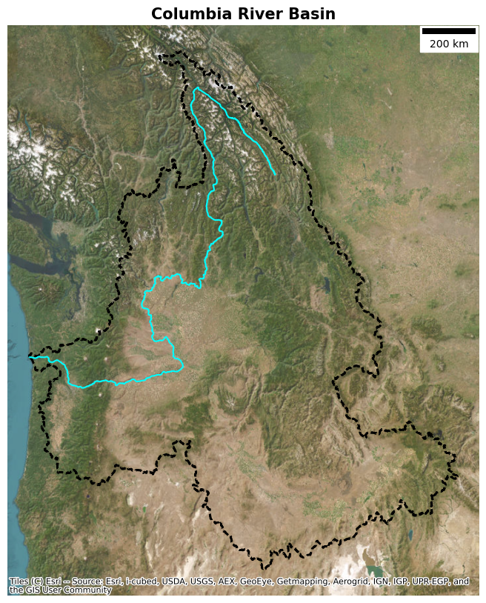
Background
How does water temperature vary along the Columbia River, and how is the temperature variation related to dam operations?
The Columbia River
2000 km
Six states (WA, OR, ID, MT, BC, NV)
14 Dams
Salmon habitat
Notes:
2. Our exploration is driven by a fundamental question:

Slide 4
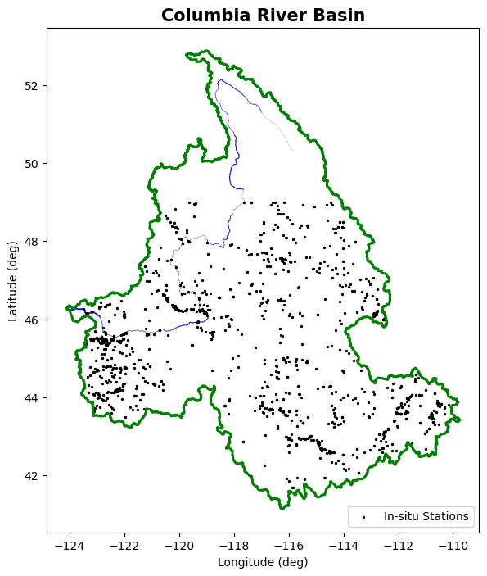

Datasets
U.S. Geological Survey (USGS)
National Hydrography Datasets - Vector Datasets (Basin, River Lines)
In-situ temperature records (1990 - 2020)
In-situ flow records (1990 - 2020)
Landsat 4, 5, 7, 8, 9
Water surface temperature (1982 - 2024)

Slide 5
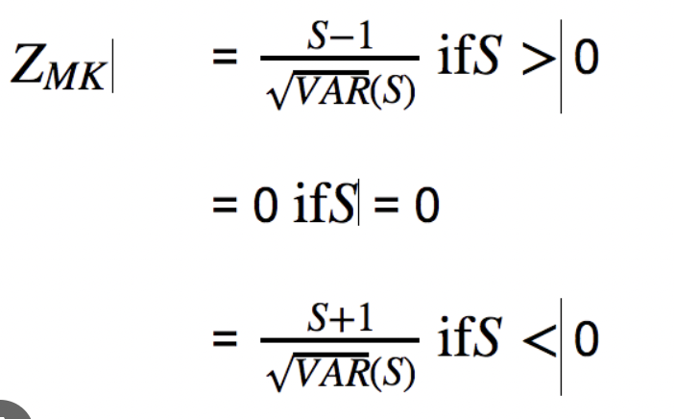
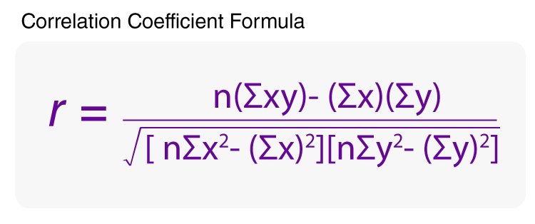
Trend Analysis Methods
Mann-Kendall Trend Test
Seasonal Trend Detecting Over a 30-Year Period
Daily Flow Data Below The Dalles
Sen’s Slope Trend Test
Daily Mean Flow Data Below The Dalles
Pearson Correlation Test
Correlation Scatterplot

Slide 6
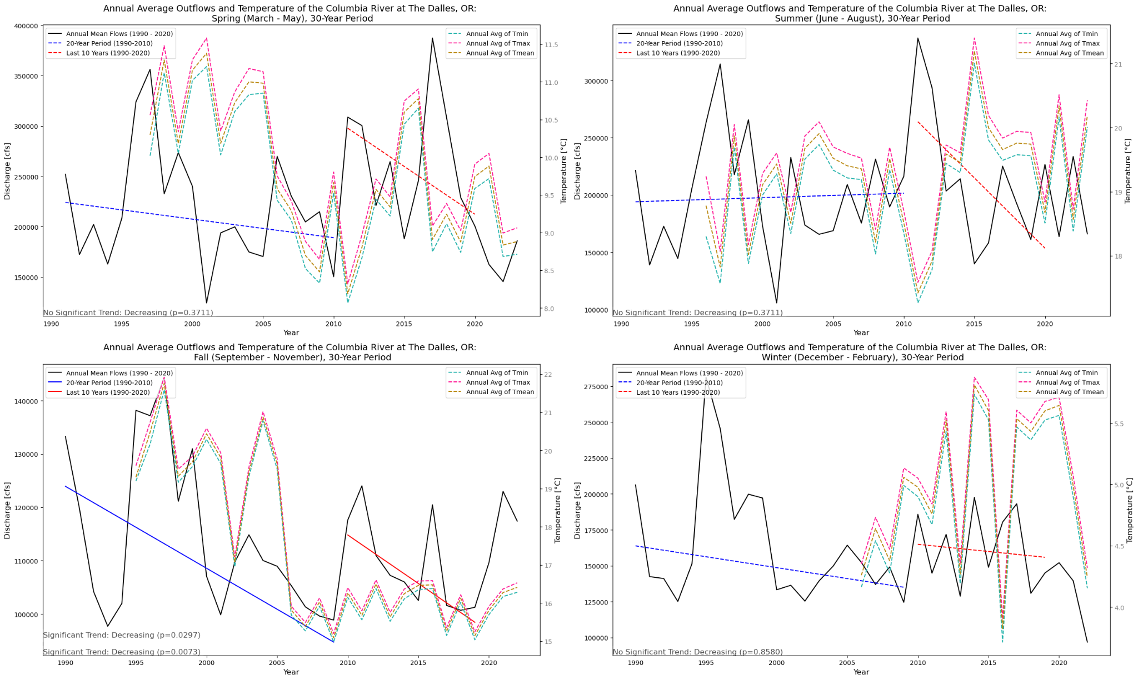
Results: Seasonal Mean Flows and Temperature

Slide 7
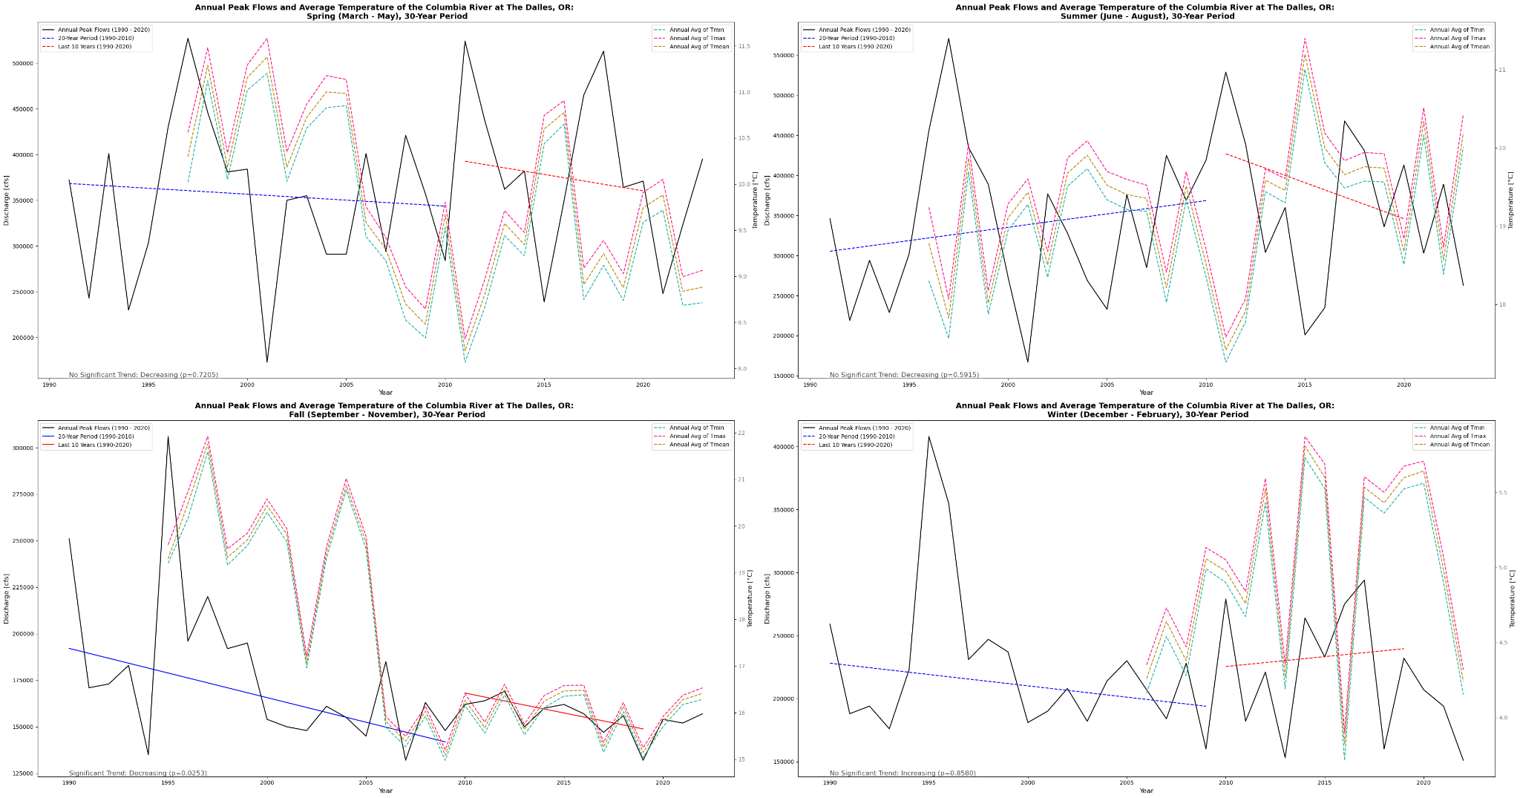
Results: Seasonal Mean Flows and Temperature

Slide 8
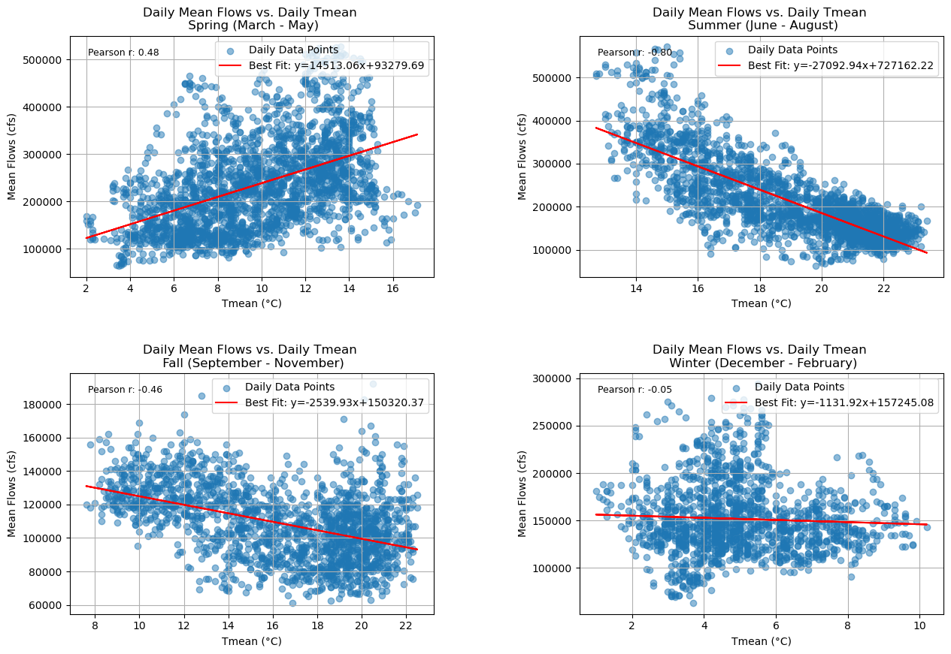

Results: Seasonal Peak Flows and Temperature

Slide 9
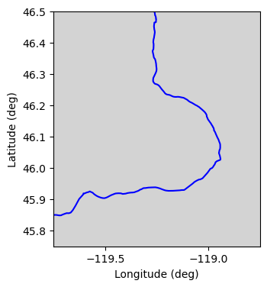
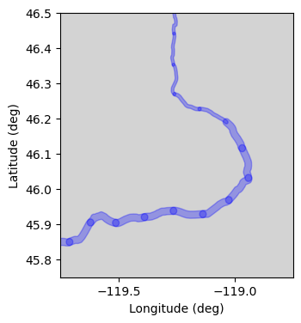
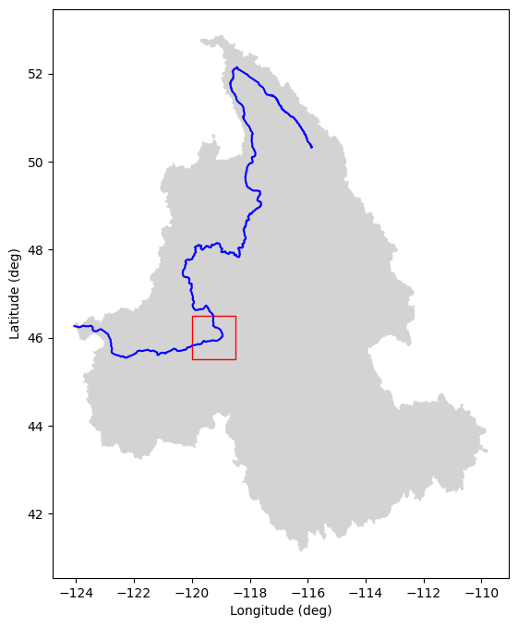
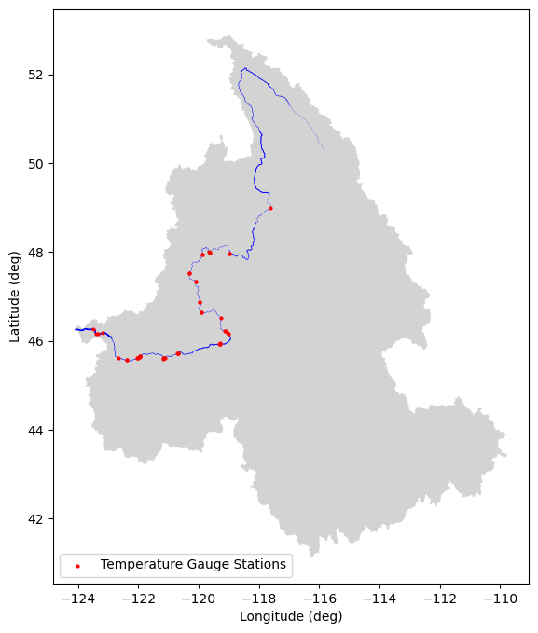
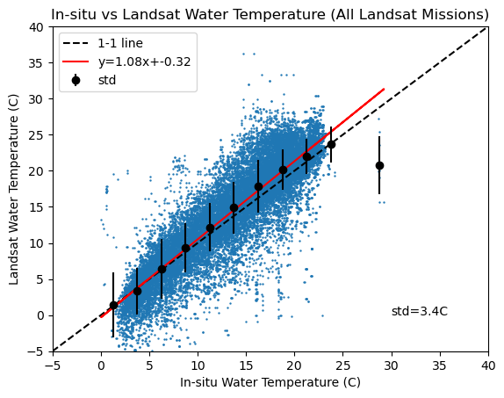

Methods: Longitudinal Temperature Profile
Equidistant Projection
10-km Segments
Width + 120 m buffer
Landsat Data
Google Earth Engine

Slide 10
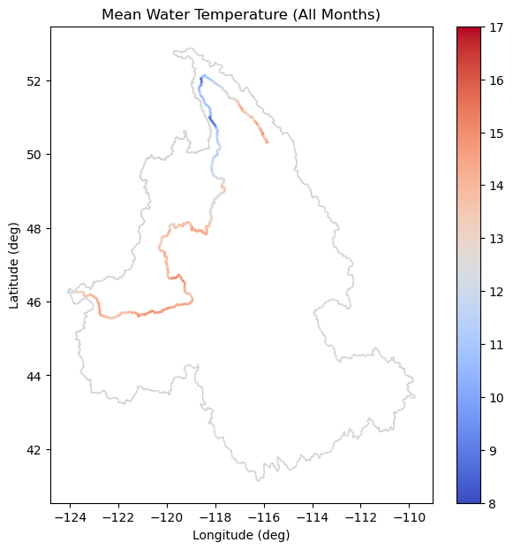
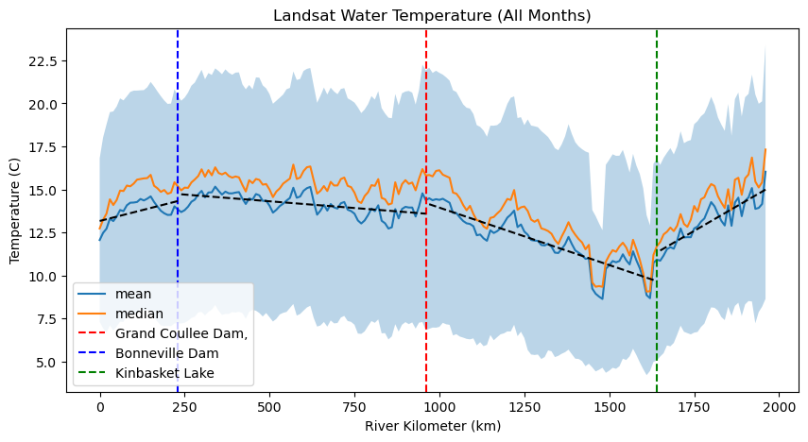
RESULTS: Longitudinal Temperature Profile (1982-2024) - All Months
Lower
Columbia
Middle
Columbia
Upper
Columbia
-0.05 C / 10 km
+0.02 C / 10 km
-0.11 C / 10 km
+0.07 C / 10 km

Slide 11
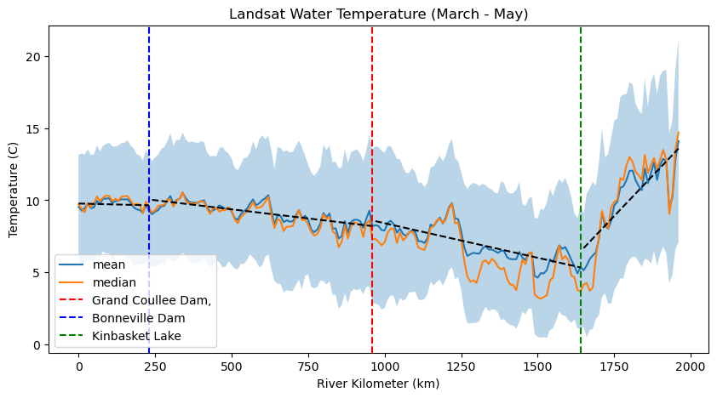
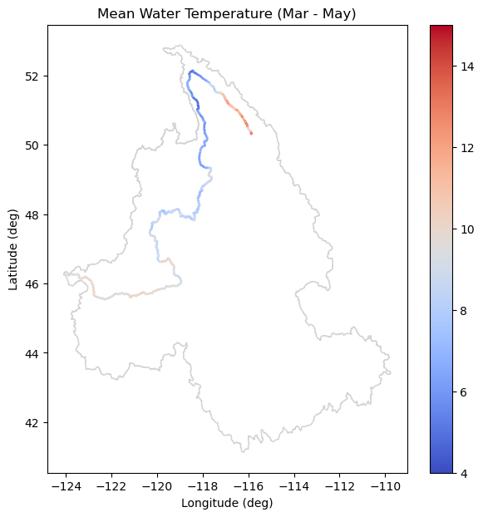
RESULTS: Longitudinal Temperature Profile (1982-2024) - March to May
Lower
Columbia
Middle
Columbia
Upper
Columbia
+0.01 C / 10 km
+0.03 C / 10 km
-0.22 C / 10 km
+0.05 C / 10 km

Slide 12
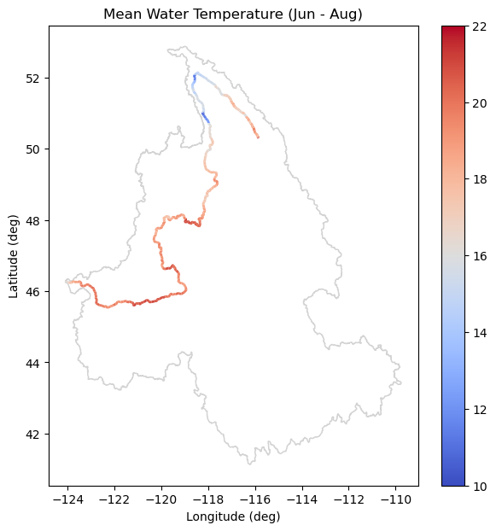
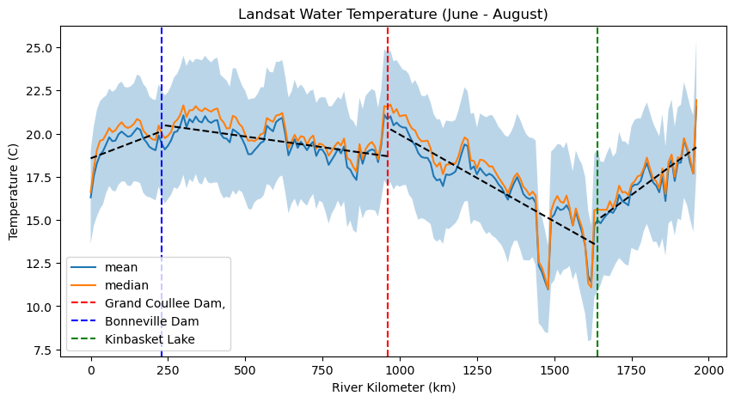
RESULTS: Longitudinal Temperature Profile (1982-2024) - June to August
Lower
Columbia
Middle
Columbia
Upper
Columbia
+0.02 C / 10 km
-0.07 C / 10 km
+0.10 C / 10 km
-0.13 C / 10 km

Slide 13
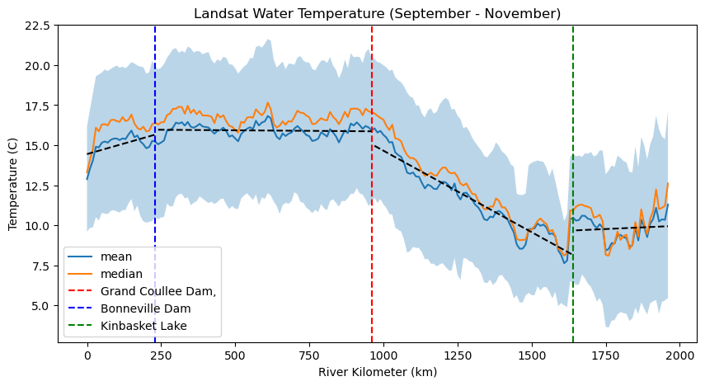
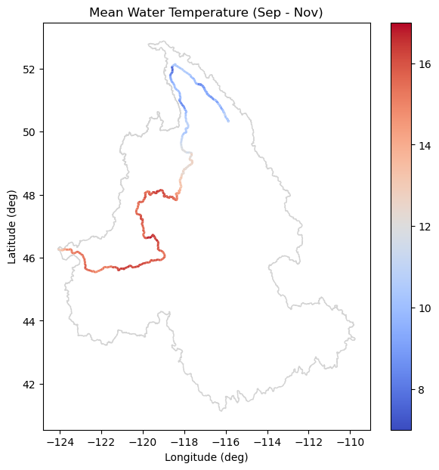
RESULTS: Longitudinal Temperature Profile (1982-2024) - September to November
Lower
Columbia
Middle
Columbia
Upper
Columbia
+0.00 C / 10 km
-0.01 C / 10 km
-0.05 C / 10 km
+0.10 C / 10 km

Slide 14
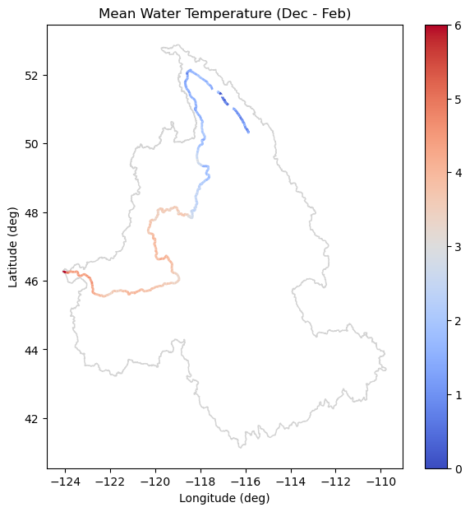
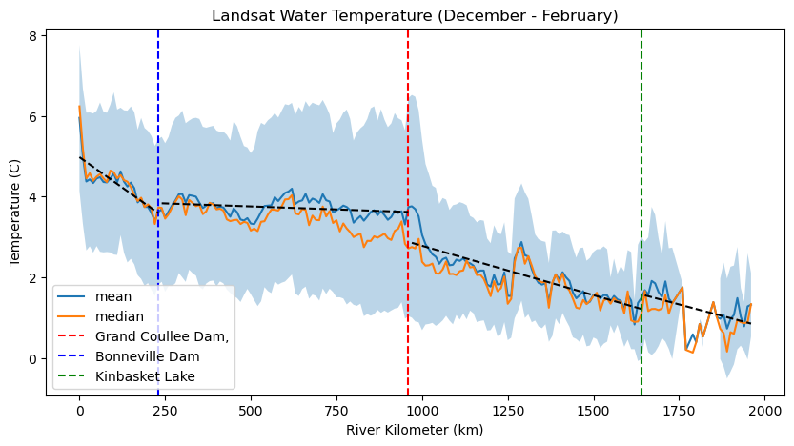
RESULTS: Longitudinal Temperature Profile (1982-2024) - December to February
Lower
Columbia
Middle
Columbia
Upper
Columbia
+0.02 C / 10 km
+0.06 C / 10 km
+0.02 C / 10 km
+0.02 C / 10 km

Slide 15
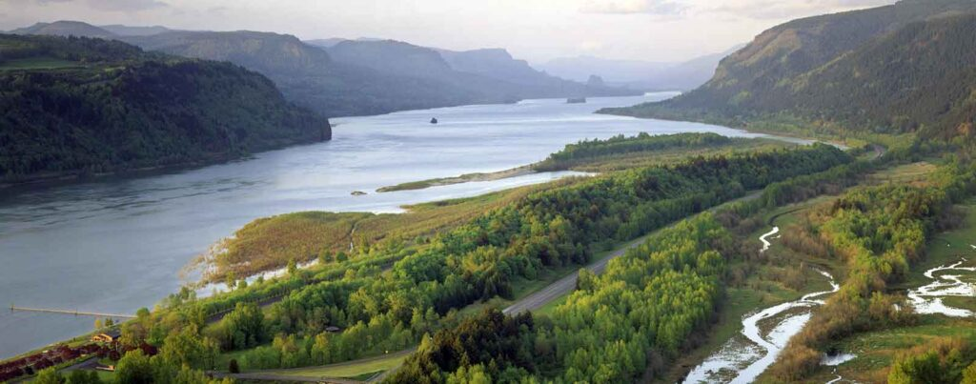
Conclusions
In general there is a downstream heating along the Columbia River.
The Middle Columbia (from Grand Coulee to Bonneville) experiences the least rate of increase in temperature along the river. This could be as a result of the dams located within this stretch of the Columbia River.
There is a summer cooling effect downstream of large dams such as the Grand Coulee. This is due to thermal stratification of the reservoir.
Seasonal Trends below The Dalles suggest decline in mean daily flows may be caused by a shift in seasonal timing (i.e. snowmelt happening earlier in the season, dry season happening faster)
Future analysis using ML applications and precipitation modeling to understand long-term effects of seasonal change and climate vulnerability of infrastructure.

Slide 16
Thank you!
Questions?

